Slide 1
HACKATHON Quora Question pairs PROBLEM

Slide 2
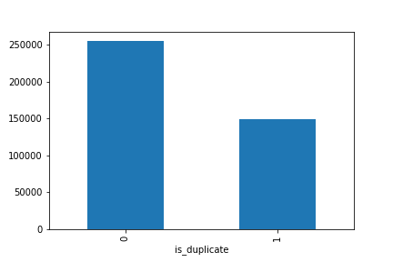
Define Evaluation Metric
Metric to evaluate results was determined by distribution of target variable
We chose Accuracy and logloss to be our evaluation metric

Slide 3
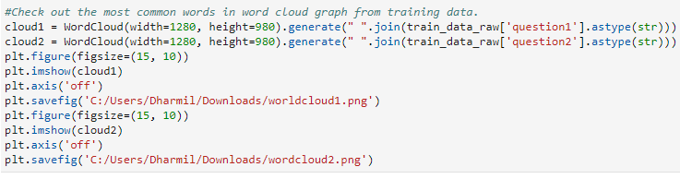


Exploratory Data Analysis

Slide 4
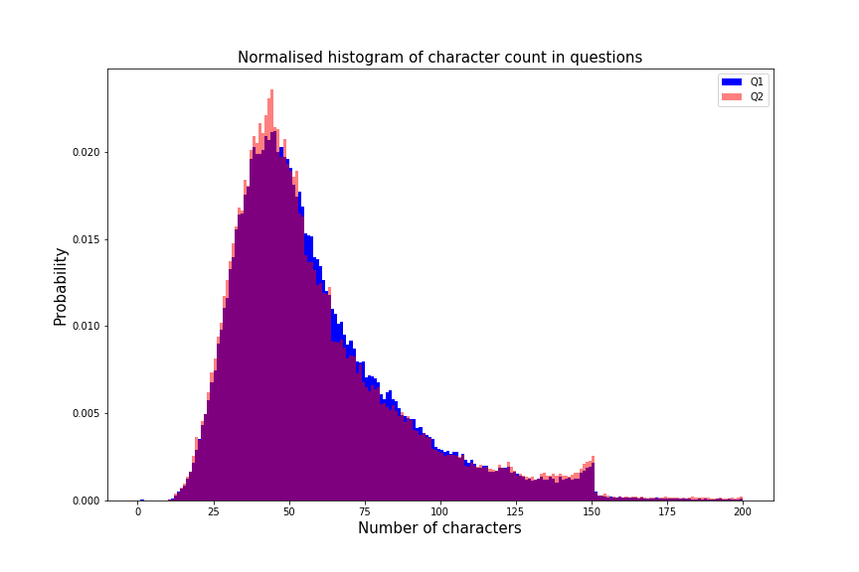
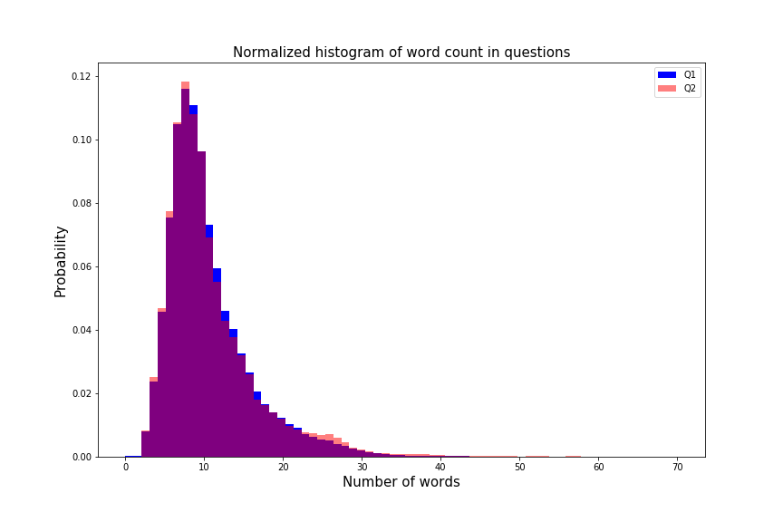
Character & Word Count

Slide 5
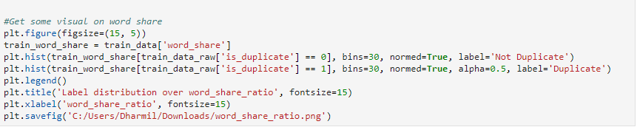
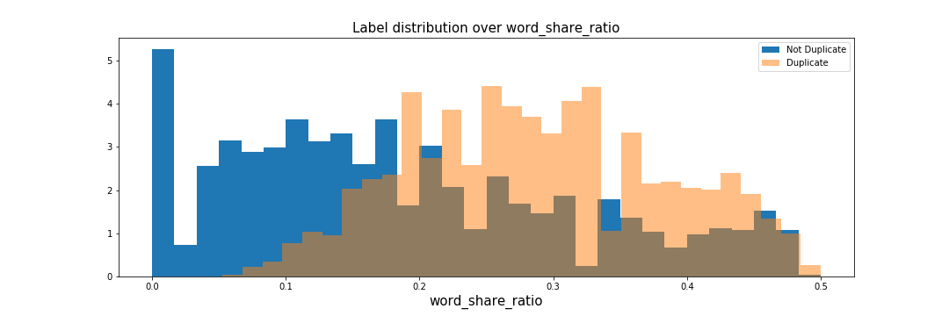
Word Share Ratio

Slide 6
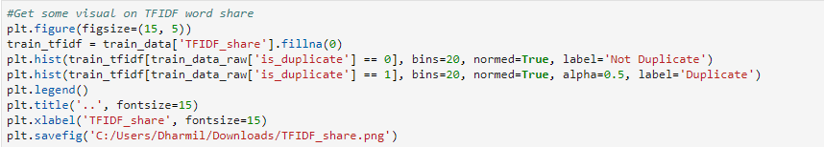
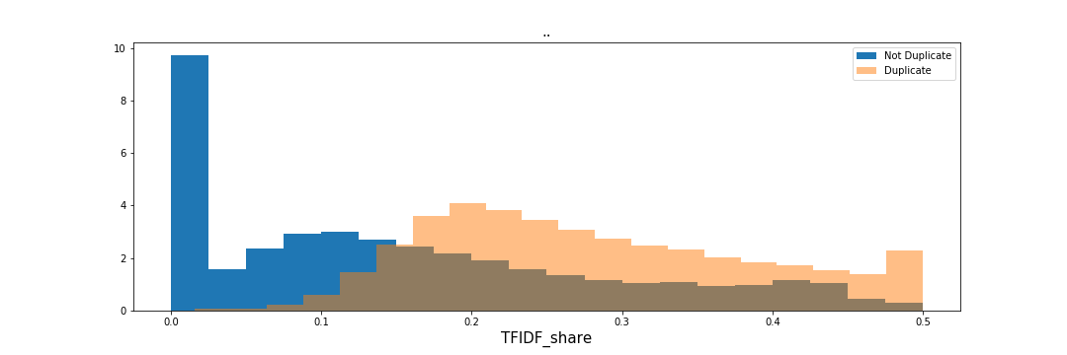
TF-IDF Share

